Slide 1
Web Technologies
JS Basics

Slide 2
Summary of Today’s Lecture
Conditional Statements
Switch Statements
Loops
Functions
Arrow Functions (ES6)
Default Parameter Values (ES6)
Rest Parameter (ES6)
Spread Parameter (ES6)
JavaScript Classes (ES6)
Error Handling
Template Literal (ES6)
Comments

Slide 3
Conditional statements
Conditional statements are used to perform different actions based on different conditions.
In JavaScript we have the following conditional statements:
  Use if to specify a block of code to be executed, if a specified condition is true
  Use else to specify a block of code to be executed, if the same condition is false
  Use else if to specify a new condition to test, if the first condition is false
  Use switch to specify many alternative blocks of code to be executed
  if( true ) {
    // Do something.
  }
  Here is a simple example using the array
    var foo = [5, "five", "5"];
    if( foo[1] === "five" ) {
    alert("This is the word five, written in plain English.");
    }
    In this case, the alert would fire because the foo variable with an index of 1 (the second in the list) is identical to “five”.

Slide 4
Conditional statements
  Use the else statement to specify a block of code to be executed if the condition is false.
    var test = "testing";
    if( test == "testing" ) {
      alert( "You haven't changed anything." );
    } else {
      alert( "You've changed something!" );
    }
  Use the else if statement to specify a new condition if the first condition is false.
  var greeting;
  var time = new Date().getHours();
    if (time < 10) {
    greeting = "Good morning";
    } else if (time < 20) {
    greeting = "Good day";
    } else {
    greeting = "Good evening";
    }

Slide 5
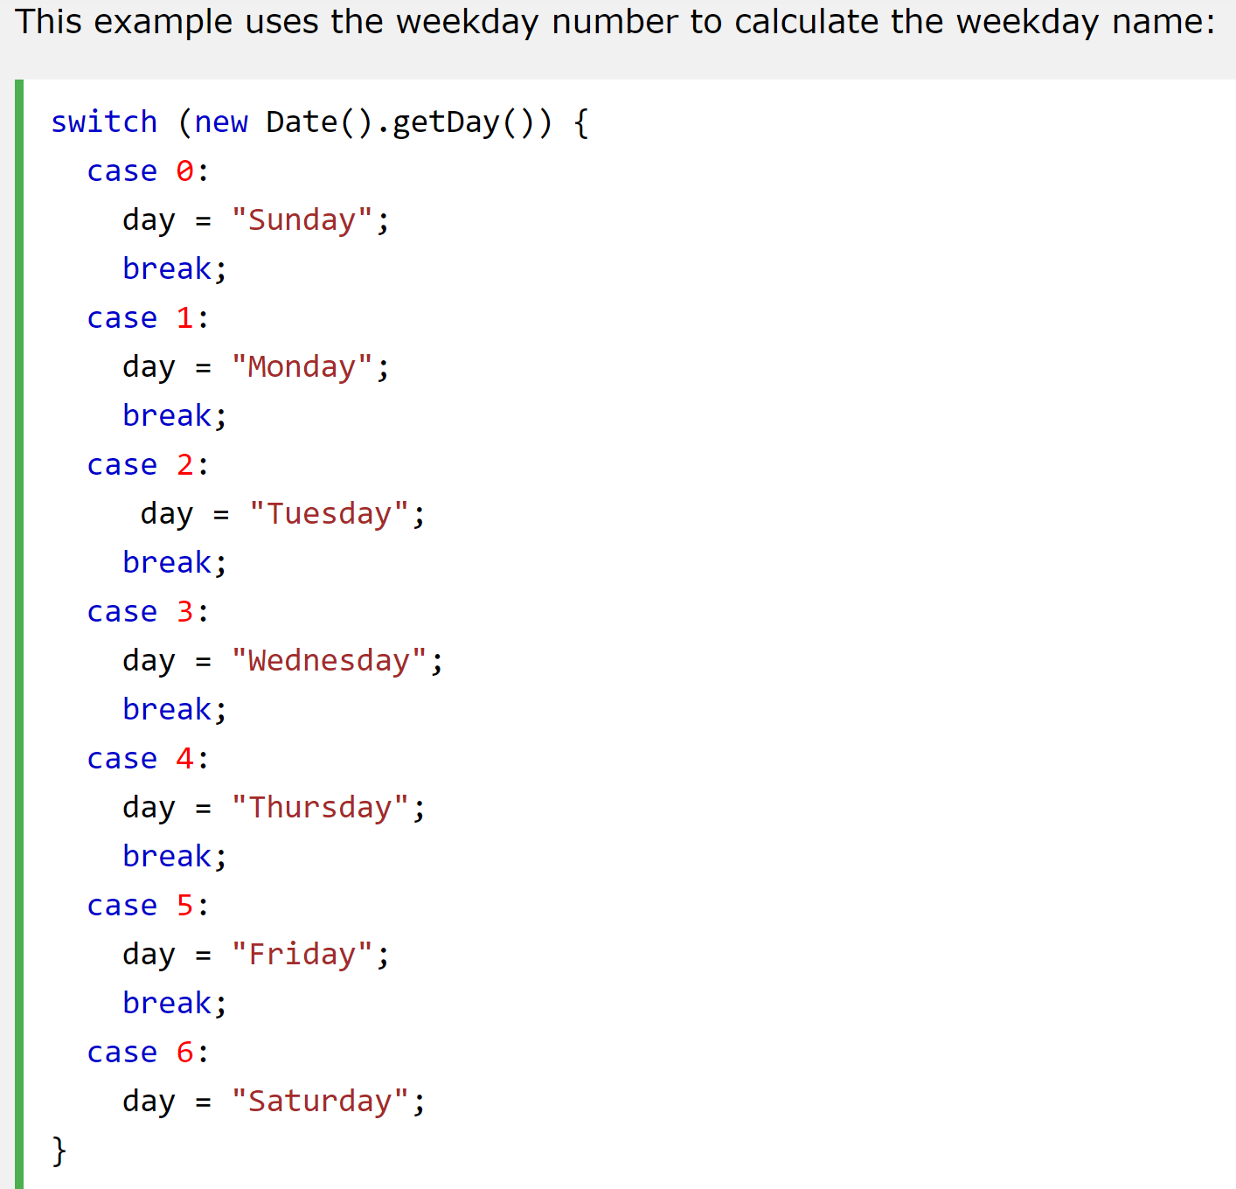
Switch Statement
  Use the switch statement to select one of many code blocks to be executed.
    switch(expression) {
    case x:
    // code block
    break;
    case y:
    // code block
    break;
    default:
    // code block
    }
This is how it works:
The switch expression is evaluated once.
The value of the expression is compared with the values of each case.
If there is a match, the associated block of code is executed.
If there is no match, the default code block is executed.
The getDay() method returns the weekday as a number between 0 and 6
(Sunday=0, Monday=1, Tuesday=2 ..)
This example uses the weekday number to calculate the weekday name:

Slide 6
Loops
There are cases in which we’ll want to go through every item in an array and do something with it.
JavaScript supports different kinds of loops:
  for - loops through a block of code a number of times
  for/in - loops through the properties of an object (for x in person)
  while - loops through a block of code while a specified condition is true
  do/while - also loops through a block of code while a specified condition is true.
for method is one of the most popular. The basic structure of a for loop is as follows:
  for(initialize the variable; test the condition; alter the value;)
  {
    // do something
  }
Here is an example of a for loop in action.
  for( var i = 0; i <= 2; i++ ) {
    alert( i ); // This loop will trigger three alerts, reading "0", "1“, and "2" respectively.
  }

Slide 7
Loop over Array
To “check each item in an array” we write a loop to do that for us?
  var items = ["foo", "bar", "baz"]; // First we create an array.
  for( var i = 0; i < items.length; i++ ) {
    alert( items[i] ); // This will alert each item in the array.
  }
items.length
  Instead of using a number to limit the number of times the loop runs, we’re using a property built right into JavaScript to determine the “length” of our array, which is the number of items it contains.
items[i]
  We can use i variable inside of the loop to reference each index of the array.

Slide 8
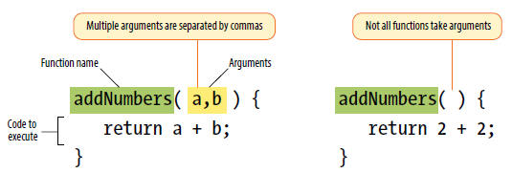
Custom Functions
A JavaScript function is a block of code designed to perform a particular task.
A function is a bit of code that doesn’t run until it is referenced or called.
A JavaScript function is defined with the function keyword, followed by a name, followed by parentheses ().
Function names can contain letters, digits, underscores, and dollar signs (same rules as variables).
Inside the function, the arguments (the parameters) behave as local variables.
When JavaScript reaches a return statement, the function will stop executing.

Slide 9
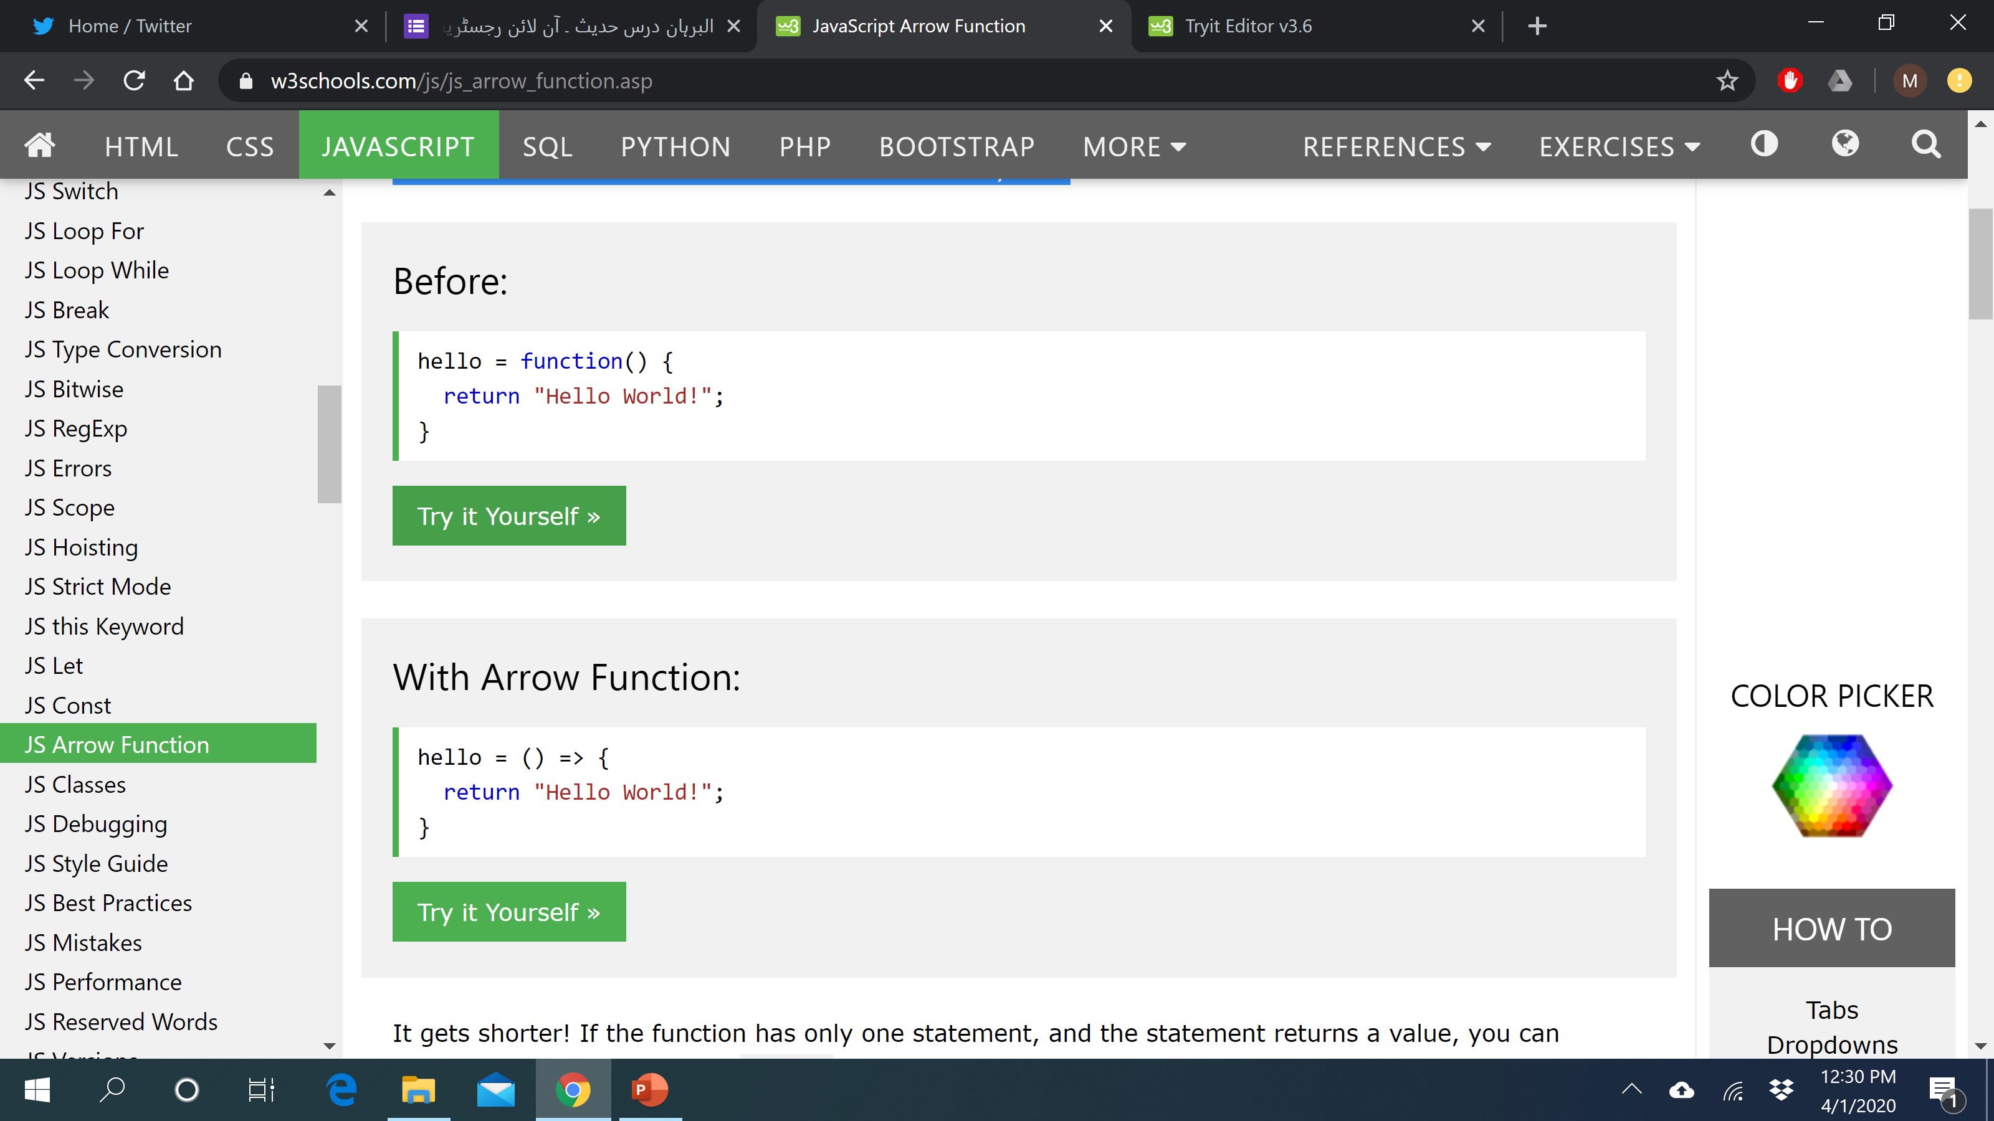
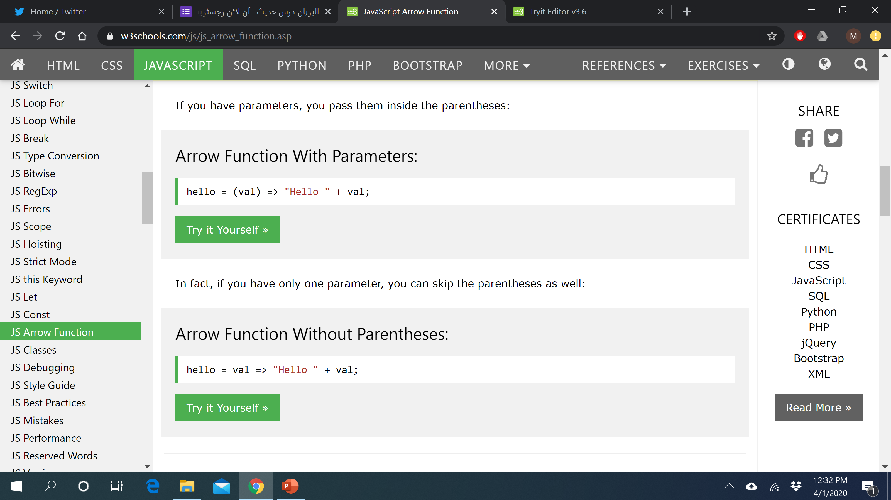
Arrow Function
Arrow functions, introduced in ES6, provides a concise way to write functions in JavaScript.
They are anonymous functions and are roughly the equivalent of lambda functions in python or blocks in Ruby.
Arrow functions are defined using a new syntax, the fat arrow (=>) notation.
If you have parameters, you pass them inside the parentheses:
If you have only one parameter, you can skip the parentheses as well:

Slide 10
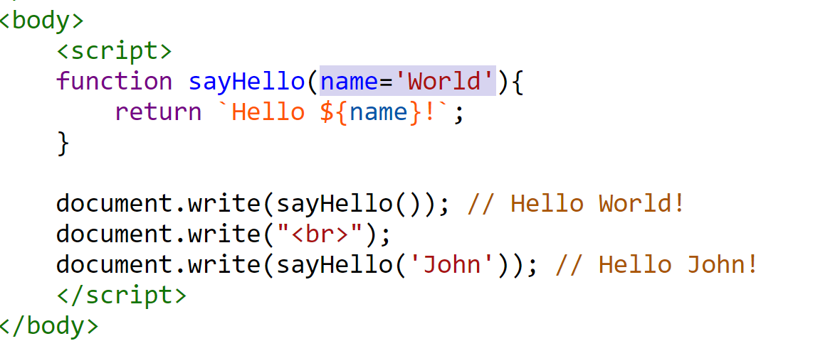

Default Values for Function Parameters
In ES6, you can specify default values to the function parameters.
This means that if no arguments are provided to function when it is called these default parameters values will be used.
Output

Slide 11
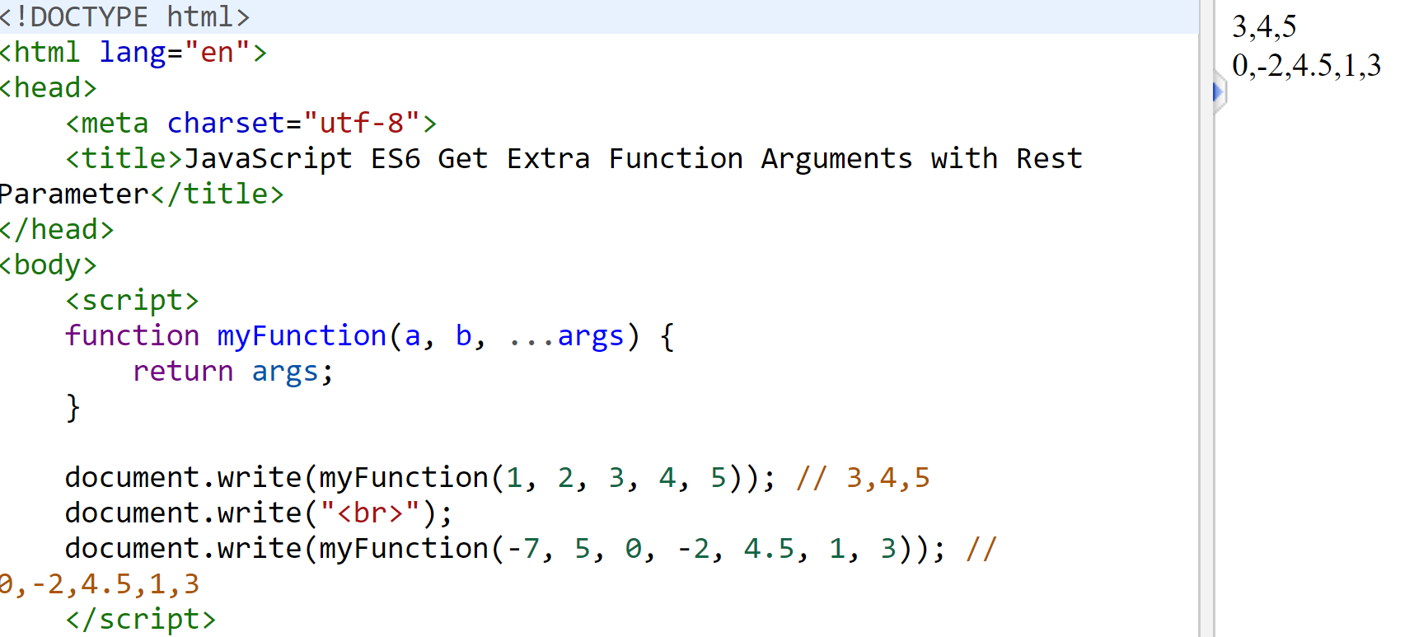
The Rest Parameter
ES6 introduces rest parameter that allows us to pass an arbitrary number of parameters to a function.
This is particularly helpful in situations when you want to pass parameters to a function, but you have no idea how many you will need.
A rest parameter is specified by prefixing a named parameter with rest operator (...) i.e. three dots.
Rest parameter can only be the last one in the list of parameters, and there can only be one rest parameter.

Slide 12
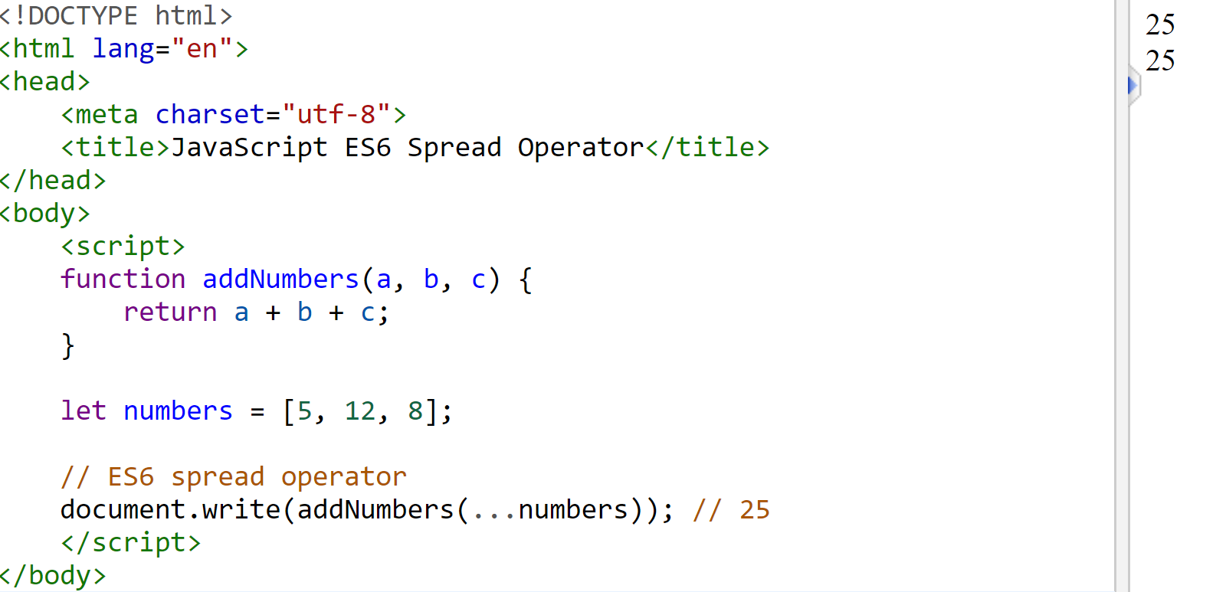
Spread Operator
The spread operator, which is also denoted by (...), performs the exact opposite function of the rest operator.
The spread operator spreads out (i.e. splits up) an array and passes the values into the specified function, as shown in the following example:

Slide 13
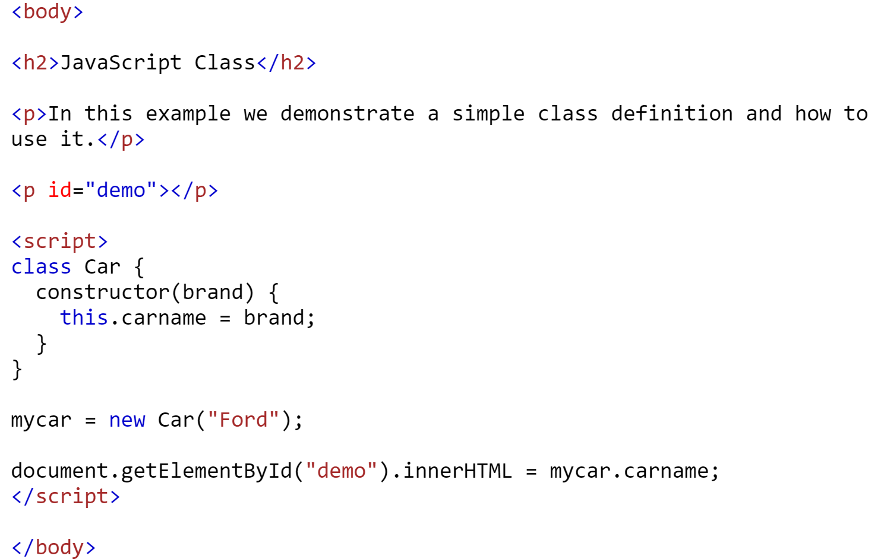

JavaScript Classes
Classes were introduced in ES6, also known as ECMAScript2015, .
A class is a type of function, but instead of using the keyword function to initiate it, we use the keyword class, and the properties are assigned inside a constructor() method.
Use the keyword class to create a class, and always add the constructor()method.
The constructor method is called each time the class object is initialized.

Slide 14
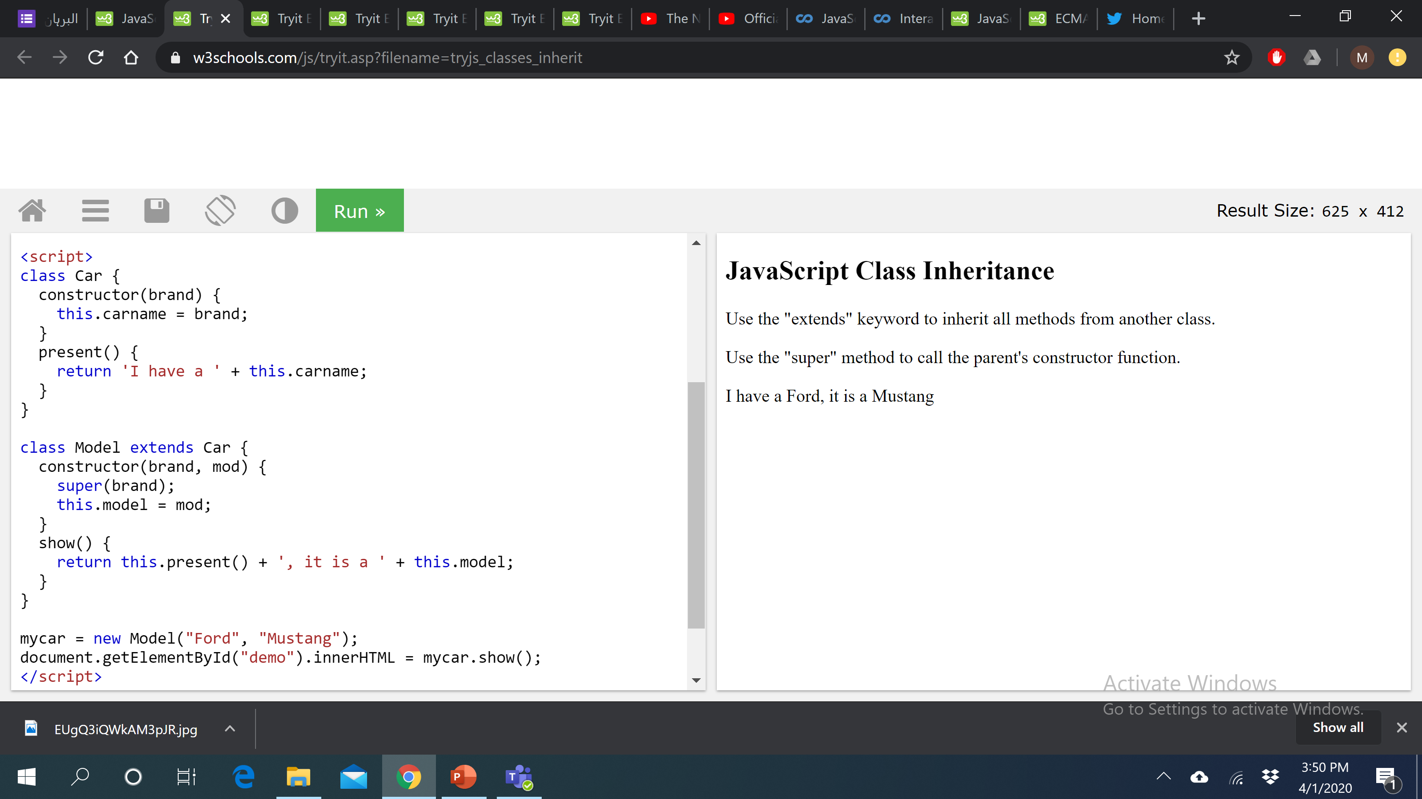
Class Inheritance
The extends keyword is used to create a child class of another class (parent). The child class inherits all the methods from another class.
Inheritance is useful for code reusability: reuse properties and methods of an existing class when you create a new class.
super() method:
The super() method refers to the parent class.
By calling the super() method in the constructor method, we call the parent's constructor method and gets access to the parent's properties and methods.

Slide 15
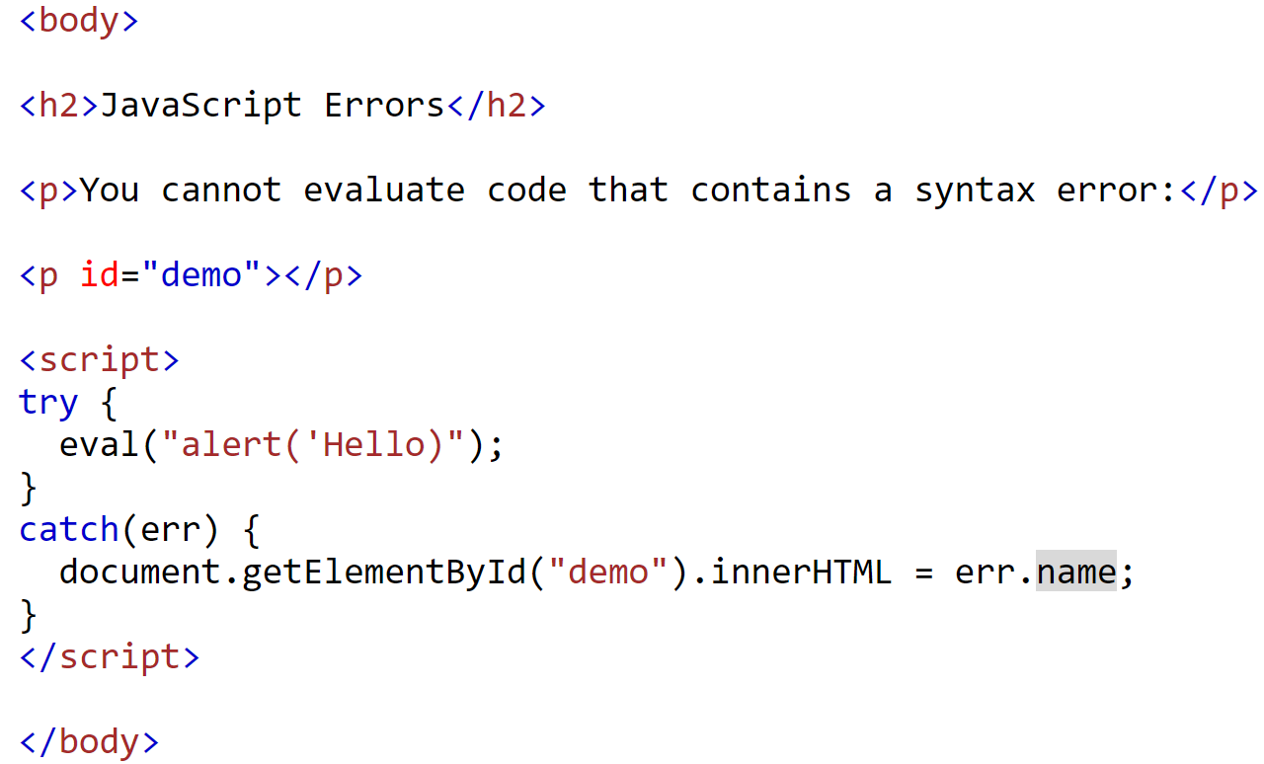
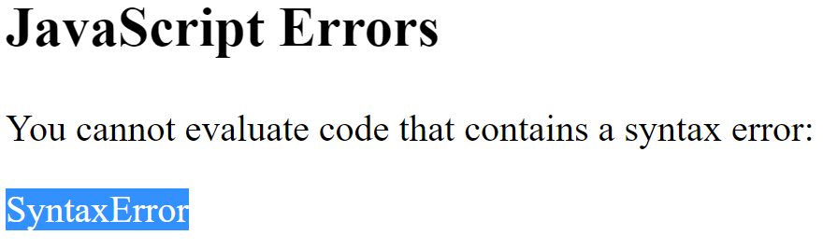
Javascript Errors
When executing JavaScript code, different errors can occur.
Errors can be coding errors made by the programmer, errors due to wrong input, and other unforeseeable things.
The try statement allows you to define a block of code to be tested for errors while it is being executed.
The catch statement allows you to define a block of code to be executed, if an error occurs in the try block.

Slide 16
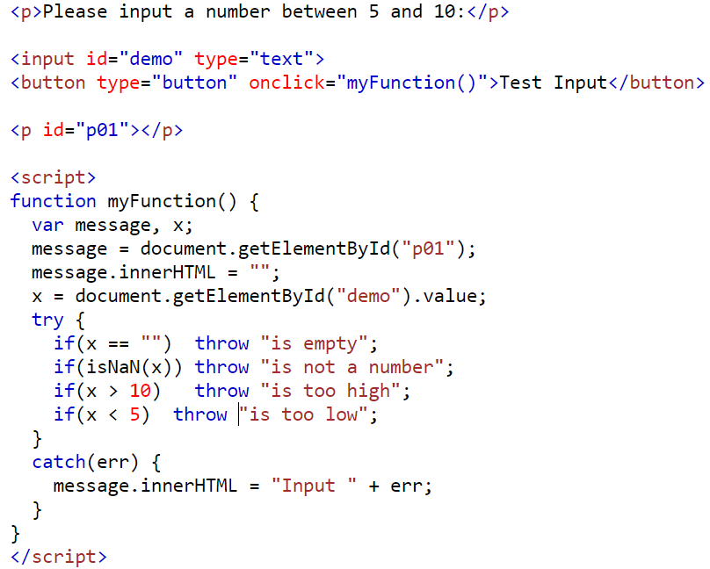
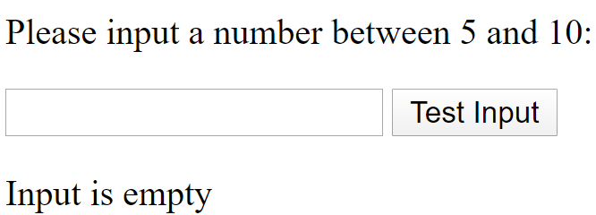
Throw Statement
The throw statement allows us to create a custom error.
Code Explanation:
This example examines input. If the value is wrong, an exception (err) is thrown.
The exception (err) is caught by the catch statement and a custom error message is displayed.

Slide 17
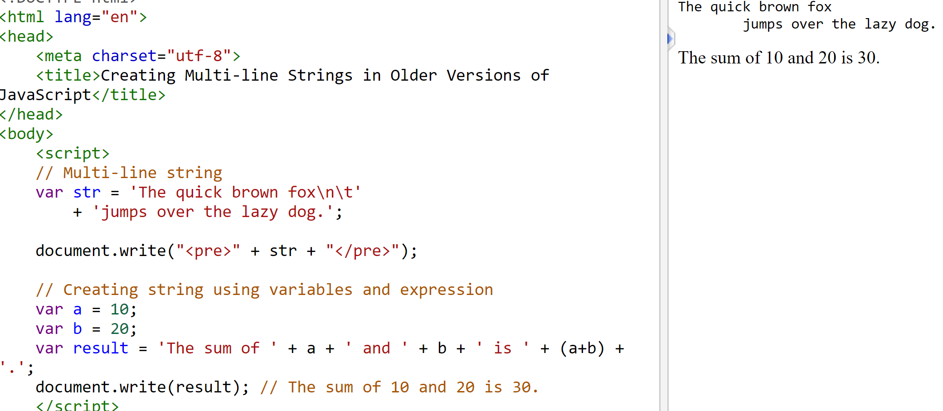
Template Literals
Template literals provide an easy and clean way create multi-line strings and perform string interpolation. Now we can embed variables or expressions into a string at any spot without any hassle.
In computer programming, string interpolation (or variable substitution) is the process of evaluating a string literal containing one or more placeholders, yielding a result in which the placeholders are replaced with their corresponding values.
Template literals are created using back-tick (` `) (grave accent) character instead of the usual double or single quotes. Variables or expressions can be placed inside the string using the ${...} syntax.
An example without template literal is provided below:

Slide 18
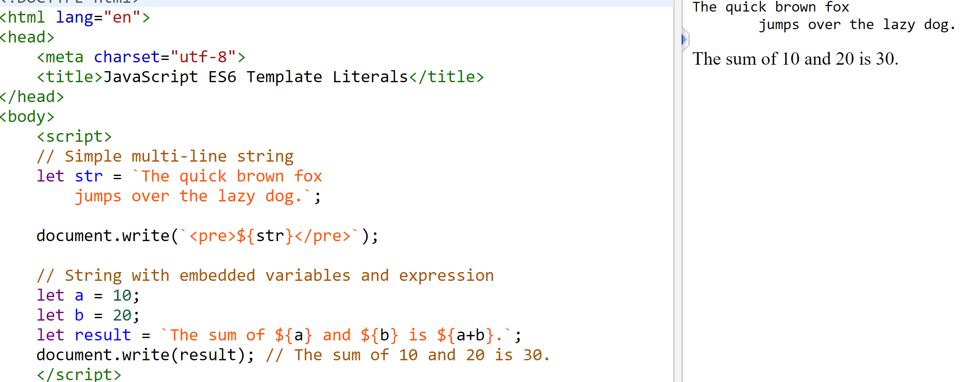
Template Literals Example
The same example as has been shown in the previous slide is provided using template literal approach

Slide 19
Comments
JavaScript comments can be used to explain JavaScript code, and to make it more readable.
Comments will be ignored at the time the script is executed, so you can leave reminders and explanations throughout your code.
There are two methods of using comments.
  For single-line comments, use two slash characters (//) at the beginning of the line.
    // This is a single-line comment.
  Multiple-line comments use the same syntax that you’ve seen in CSS.
  Everything within the /* */ characters is ignored by the browser.
    /* This is a multi-line comment.
      Anything between these sets of characters will be
      completely ignored when the script is executed.
    This form of comment needs to be closed. */

Slide 20
Summary of Today’s Lecture
Conditional Statements
Switch Statements
Loops
Functions
Arrow Functions (ES6)
Default Parameter Values (ES6)
Rest Parameter (ES6)
Spread Parameter (ES6)
JavaScript Classes (ES6)
Error Handling
Template Literal (ES6)
Comments

Slide 21
Resources
Chapter 19 and Chapter 20 from Learning Web Design- A Beginner’s Guide to HTML, CSS, Javascript and Web Graphics By Jennifer Niederst Robbins (4th Edition)
https://www.w3schools.com/js/js_array_sort.asp
https://www.w3schools.com/js/js_best_practices.asp
https://www.w3schools.com/js/js_errors.asp
https://www.tutorialrepublic.com/javascript-tutorial/javascript-es6-features.php

